Slide 1
Creating Student Web Pages
Rob Honomichl
Dakota State University

Slide 2
Please Don’t Shoot Me
Let’s have a conversation.

Slide 3
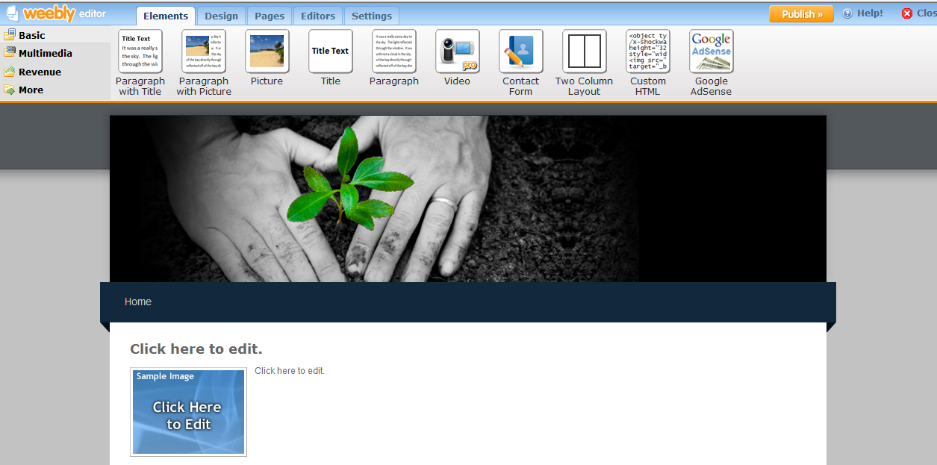
Weebly
Easy Drag and Drop
http://www.weebly.com/
http://pitrescue.weebly.com/

Slide 4
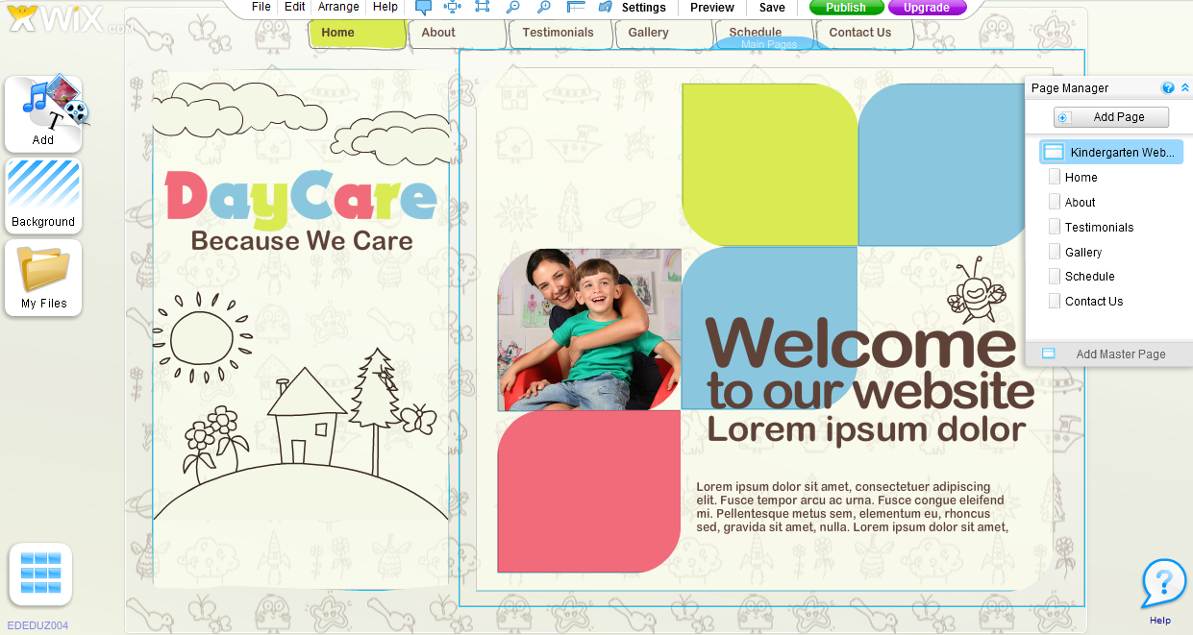
http://wix.com

Slide 5
http://google.com/sites

Slide 6
http://yola.com

Slide 7
Okay here are some more to look at.
http://www.webs.com/
http://www.moonfruit.com/
http://webstarts.com/
http://www.edicy.com/
http://www.jimdo.com/index.php
http://sitekreator.com/sitekreator/index.html

